Slide 1
Advanced Harness Routing Planner
SAPTARSI ROY

Slide 2
Table of Contents
Current Designer Workflow
Objective
Concept
Rapidly-exploring Random Tree
Algorithm Enhancements for Harness Routing
Path Refinement
Geometry Generation
Sub-Branch Creation
Designer Productivity Improvement (Tentative)
Capabilities Beyond Current CAD Tools
Future Improvements/Work
Links and References

Slide 3
Current Designer Workflow
Today, harness routing typically involves:
Identifying two connector endpoints
Studying surrounding aircraft structure
Manually sketching a potential branch route
Checking for interference
Iteratively adjusting the route
In congested aircraft regions, designers may repeat this process multiple times before finalising a feasible route.

Slide 4
Objective
Provide designers with a routing assistance tool that:
• suggests collision-free routing candidates • accelerates early path exploration • allows designers to quickly evaluate routing feasibility
The designer still decides the final routing strategy.

Slide 5
Concept
Instead of manually testing routing paths, the system:
• analyses the surrounding environment • generates candidate paths between connectors • ensures obstacle avoidance
The designer can then select, adjust, or refine the generated route.

Slide 6
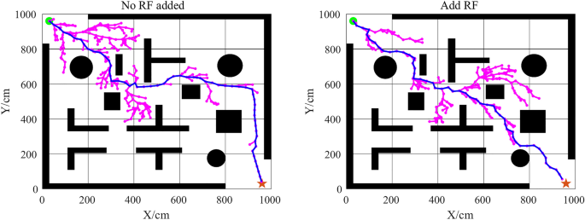
Rapidly-exploring Random Tree
The approach is inspired by the Rapidly-exploring Random Tree (RRT) algorithm.
RRT efficiently explores complex spaces to discover feasible paths while avoiding obstacles.
This concept is widely used in robotics and autonomous navigation.

Slide 7
Algorithm Enhancements for Harness Routing
The standard RRT approach was adapted for harness design by introducing:
Directional Bias
Random exploration is biased toward the vector connecting the two connector endpoints.
Benefits:
• reduces unnecessary exploration • produces routing paths closer to real harness behaviour • improves convergence speed

Slide 8
Path Refinement
After the initial path is generated, the algorithm performs:
• node reduction • shortcut optimisation • spline smoothing
The resulting route becomes suitable for harness modelling.

Slide 9
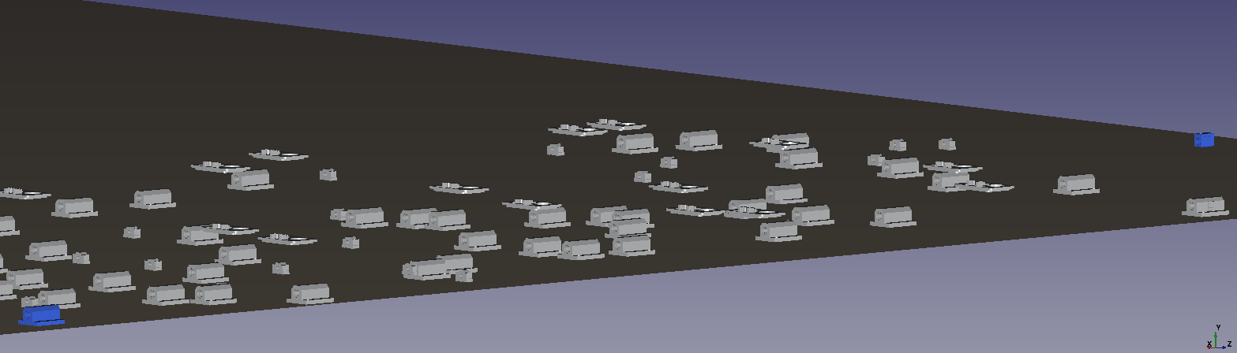
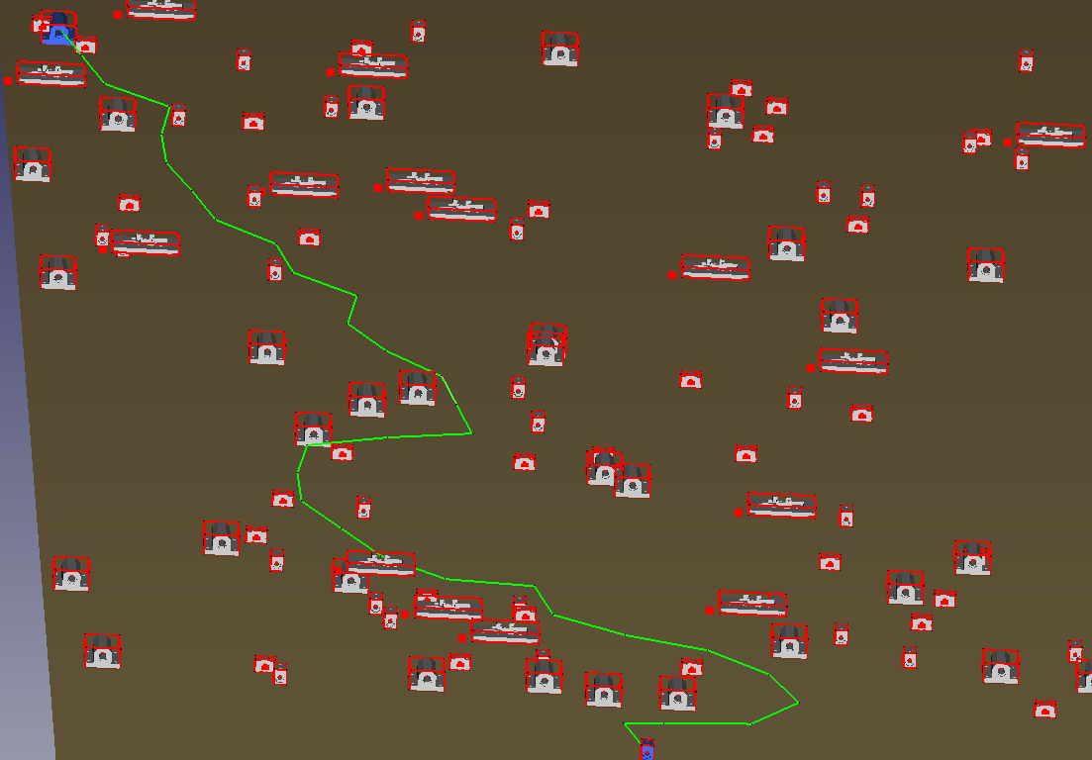
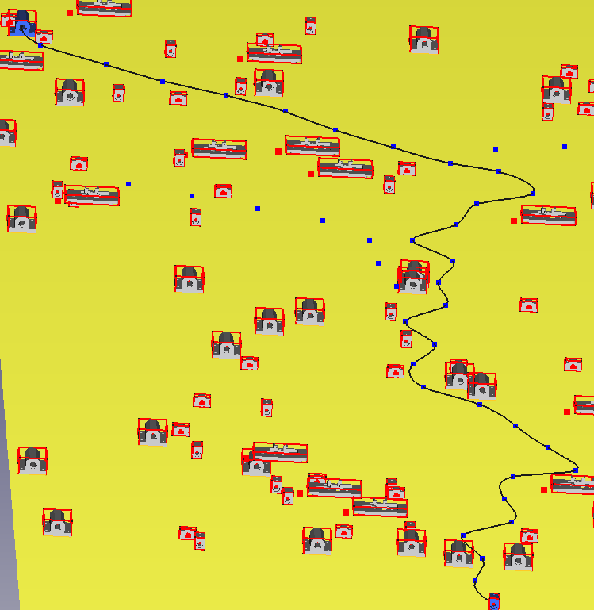
Fig 1: Just the connectors and standard paths
Fig 2: Path generated by RRT, Biasing, Smoothening, Cleaning
Fig 3: B-Spline generating after cleaning the path

Slide 10
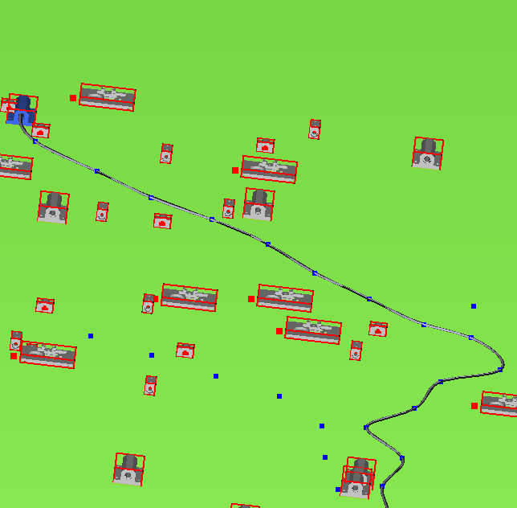
Geometry Generation
The refined path is converted into a smooth curve using **B-spline interpolation.
The spline is then used to generate the harness branch geometry.
This produces a visual and manufacturable harness representation.
Fig 4: Branch generation on the spline

Slide 11
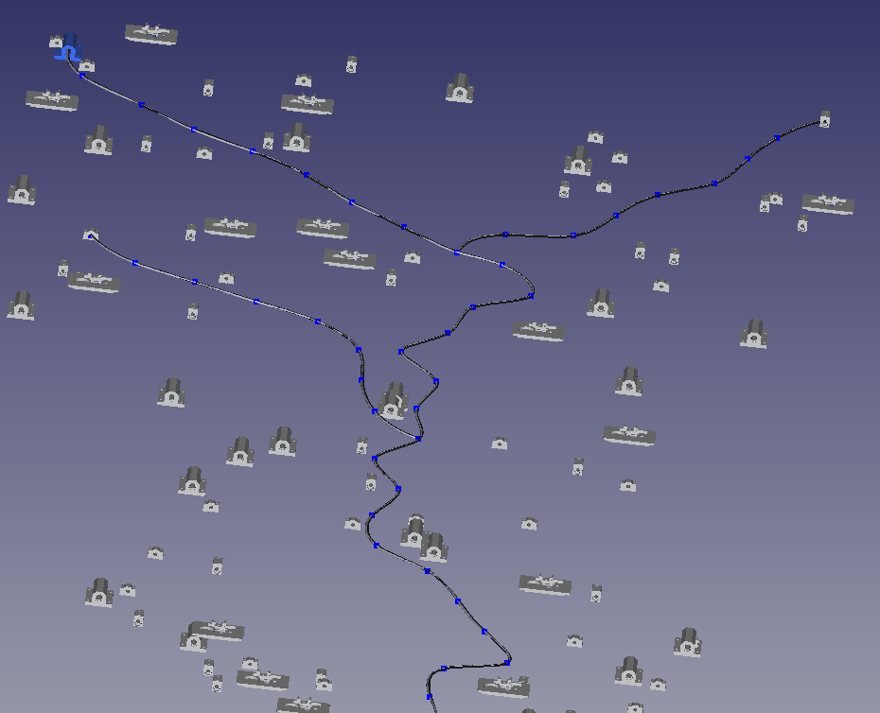
Sub-Branch Creation
The system also enables designers to:
• select a point along an existing harness branch • connect a new connector in that region • generate a secondary branch automatically
This supports the modelling of complex harness tree structures.
Fig 5: Sub Branches created from main branch

Slide 12
Designer Productivity Improvement (Tentative)
This Algorithm aims at reducing the time spent exploring routing possibilities.
Estimated productivity impact:
Design Activity | Improvement
Initial routing exploration | 40–60% faster
Identifying obstacle-free paths | 50–70% faster
Early feasibility checks (DMU) | 60% faster
Overall estimated improvement in routing preparation stage:
~30–40% reduction in exploration time

Slide 13
Capabilities Beyond Current CAD Tools
Current capabilities in CATIA V5 focus primarily on manual modelling and clash detection.
The proposed approach adds:
• automated path exploration • obstacle-aware route suggestion • rapid routing feasibility checks
These capabilities complement existing CAD tools rather than replacing them.

Slide 14
Future Improvements/Work
Improve computation time for even more complex aircraft assemblies.
Improve trimming of unnecessary path slack.
Create a robust global slack function. (Currently an approximate slack value has been used)
Machine Learning Layer for improved biasing and correction.
Implement it all in CATIA v5/3D experience

Slide 15
Links and References
Github Link: https://github.com/SAPTRAY5/Advanced_Harness_Routing_Planner
References:
https://wiki.freecad.org/Part_scripting
https://www.geeksforgeeks.org/computer-graphics/b-spline-curve-in-computer-graphics/
https://demonstrations.wolfram.com/RapidlyExploringRandomTreeRRTAndRRT/

